Slide 1

Wrapping Things Up
Lecture 40
CS61B, Fall 2023 @ UC Berkeley
Slide Credit: Josh Hug

Slide 2
61B in 12 Minutes or Less
61B in 12 Minutes or Less
Your Future
AMA
Course Reflections
Lecture 40, CS61B, Spring 2023

Slide 3
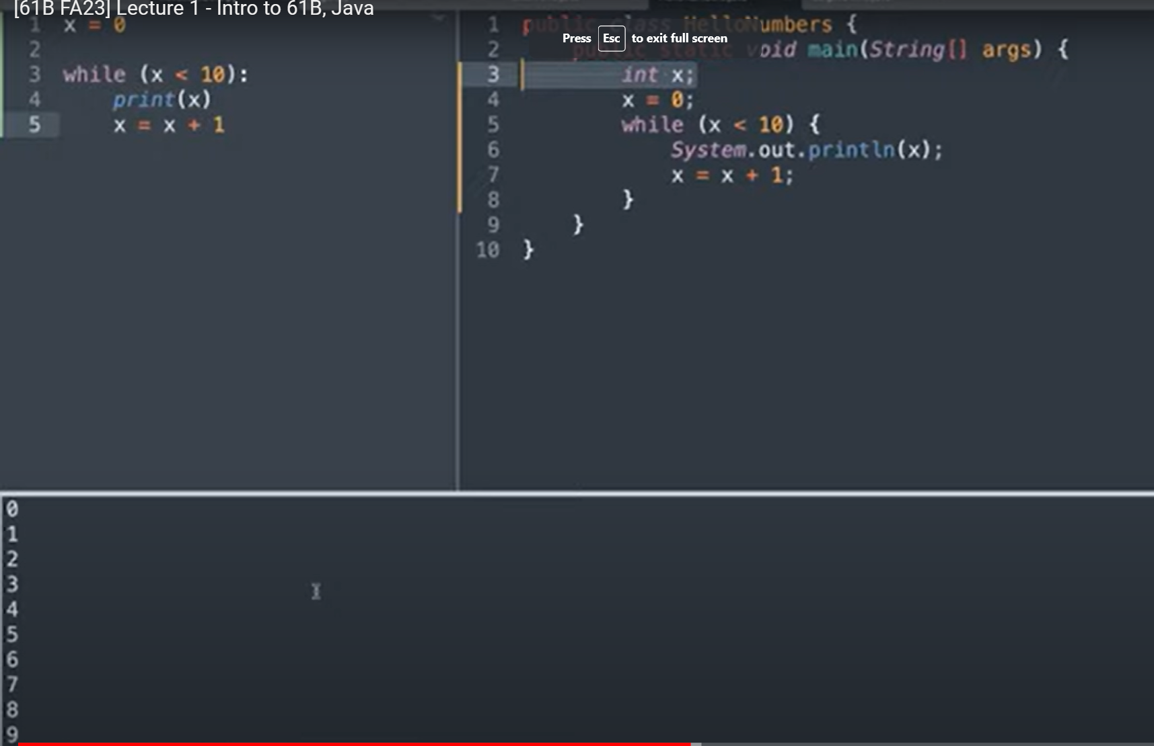
Where We Started
Just 14 weeks ago:

Slide 4
What We’ve Learned about Programming Languages
Object based programming: Organize around objects.
Object oriented programming:
Interface Inheritance.
Implementation inheritance.
Dynamic vs. static typing.
Generic Programming, e.g. ArrayList<Integer>, etc.
The model of memory as boxes containing bits.
Bit representation of positive integers.
Java.
Some standard programming idioms/patterns:
Objects as function containers (e.g. Comparators, IntUnaryFunctions).
Default method specification in interfaces (Link).
Iterators.
Example: Programmer only needs to know List API, doesn’t have to know that ArrayList secretly does array resizing.
Example: Array is a sequence of boxes. An array variable is a box containing address of sequences of boxes.

Slide 5
Important Data Structures in Java
Important data structure interfaces:
java.util.Collection (and its subtypes).
With a special emphasis on Map (and its subtypes).
Our own Collections (e.g. Map61B, Deque): Didn’t actually extend Collection.
Concrete implementations of these abstract implementations:
Examples: ArrayDeque implements Deque.

Slide 6
Mathematical Analysis of Data Structure/Algorithm Performance
Asymptotic analysis.
O(·), Ω(·), Θ(·), and tilde notation.
Worst case vs. average case vs. best case.
Exemplar of usefulness of average case: Quicksort
Determining the runtime of code through inspection (often requires deep thought).
Multiplicative resizing is much better than additive resizing.
Multiplicative resizing results in Θ(1) add runtime for ArrayLists.
Additive resizing results in Θ(N) add runtime for ArrayLists.

Slide 7
Some Examples of Implementations for ADTs
Chaining HT
LinkedList
List
Resizing Array
Heap
Set
LinkedList
PQ
Balanced Tree
Resizing Array
Map
Ordered Linked List
Quick Find
BST (no balancing)
Quick Union
Red Black
DisjointSets
WeightedQuickUnionUF
B-Trees (2-3 / 2-3-4)
WQUPC
Adjacency Matrix
Trie
Graph
Edge List
Heap
Adjacency Lists

Slide 8
Arrays vs. Linked Data Structures
Array-Based Data Structures:
ArrayLists and ArrayDeque
HashSets, HashMaps, MyHashMap: Arrays of ‘buckets’
ArrayHeap (tree represented as an array)
Linked Data Structures
Linked Lists
LinkedList, IntList, LinkedListDeque, SLList, DLList
Trees: Hierarchical generalization of a linked list. Aim for bushiness.
TreeSet, TreeMap, BSTMap, Tries (trie links often stored as arrays)
Graphs: Generalization of a tree (including many algorithms).
Tradeoffs of array-based vs. linked data structures.
Notes:
Write out code that inserts into a tree, for example. How find 5th largest, that sort of thing.

Slide 9
Tractable Graph Problems and Algorithms
Topological Sort
vertex ordering
Reachability
DFS Traversal
Bipartiteness
vertex markings
Discussed in section
Cycle Detection
BFS Traversal
Multiple Target
Shortest Paths by # of Edges
shortest paths tree
Prim’s
Minimum Spanning Tree
Minimum Spanning Tree
Kruskal’s
Multiple Target
Shortest Paths by Total Edge Weight
Dijkstra’s
shortest paths tree
DAGSPT
Single Target Shortest Paths by Total Edge Weight
shortest path
A*

Slide 10
Search-By-Key-Identity Data Structures:
2-3 Tree
Searches using compareTo()
Analogous to Comparison-Based
Set
RedBlack
Map
External Chains
Searches using hashCode() and equals()
Roughly Analogous to Integer Sorting
Linear Probing
Trie / TST
Searches by digit. Analogous to Radix Sorting
Comparison Based Sorting Algorithms: Ω(N log N) worst case
Radix Sorting Algorithms: Θ(NW) worst case:
(require a sorting subroutine)
Selection
If heapify first
Heapsort
Merge
LSD
Partition
Counting
MSD
Insertion
If store in helper BST, eq. to
Small-Alphabet (Integer) Sorting Algorithms: Θ(N) worst case
Counting

Slide 11
Fun/Weird Topics (This Week)
Compression:
Huffman Coding, and selection of data structures for Huffman Coding.
Other approaches: LZW and Run Length Encoding (extra slides).
Compression, Complexity, and P=NP:
Optimal compression is impossible.
Bounded space/time compression is possible if P=NP.
Allows you to find arbitrarily short programs that produce a given output in a given runtime.
Compression of a stream of bits might provide a useful model of that stream of bits (e.g. hugPlant.bmp -> hugPlant.java).
If P = NP, we could also solve all kinds of other interesting problems.

Slide 12
The Practice of Programming
Java syntax and idioms.
Unit testing (and its more extreme form: Test-driven development).
Mining the web for code.
Debugging:
Identify the simplest case affected by the bug.
Hunt it down, giving it no place to hide.
With the right methodology, can find bugs even when finding bug through manual code inspection is impossible.
Tactical vs. Strategic Programming.
Avoid information leakage. Build deep modules. Minimize dependencies. Minimize obscurity.
Real tools: IntelliJ, git, Truth, command line.
Data structure selection (and API Design)
Drive the performance and implementation of your entire program.
Notes:
13 minutes of a rant

Slide 13
Your Future
61B in 12 Minutes or Less
Your Future
AMA
Course Reflections
Lecture 40, CS61B, Spring 2023

Slide 14
Your Life
Two immediate questions:
What classes should I take next semester?
How should I prepare for the final?
Two long-term questions:
What am I capable of achieving?
What should I do with my life?

Slide 15
Class Poll (Your Answer)
How many students are happy with the grade they are on track to receive?

Slide 16
Class Poll (Your Answer)
What does a good grade in this class mean? How will a good grade in this class affect you?
Determines if you can declare CS
Grad school/working in a company
Mastery of the material
Bragging rights
Conceptualization: Can you use this outside toy examples?

Slide 17
Class Poll (My Answer)
What does a good grade in this class mean? How will a good grade in this class affect you?
A grade in this course is not a measure of your worth/intelligence.
Several ways your grade could affect your future:
Future job prospects/grad school?
While GPA is a factor, it's often not a very important one. Once you get into industry, job experience matters much more than college GPA.
GPA requirement to enter the CS major
Unfortunately, this is a big determinator of getting into the major. Every faculty member and lecturer hates the GPA requirement because it incentivizes the wrong way to think about your grades
Fortunately, students admitted after FA23 won't have that GPA requirement.

Slide 18
What does your grade mean?
I would argue that the most important thing your grade tells you is how hard your next semester will be.
Most of the time, you don't truly master a concept until you're forced to use it to solve something new. A lot of the concepts we've covered in the last half of the course will only solidify when you start taking 61C, 170, or any other "next step" class.
The grade you get in this course is my message to you saying how difficult I predict it will be to develop that mastery in your next class.

Slide 19
What does your grade mean?
An A in this class is a signifier of mastery. If you take a sequel course, you will likely do well even with other work on your plate. So you can take more/harder courses.
A B in this class is a signifier of comprehension. If you take a sequel course, you will likely do well if you dedicate sufficient time to the class.
A C in this class is a signifier of competence. If you take a sequel course, you will likely need to devote more time than usual to do well. So try to avoid taking too many courses at the same time
Anything below a C is a signifier that you will struggle in a sequel course. Going directly to a sequel course will likely not be worthwhile. It may be good to retake the course so you get more time to digest concepts.
Like surfing: Once you're behind a wave, it's difficult to climb it
But if you're ahead of the wave, it pushes you forward
If you're behind the wave, it may be best to wait for the next wave

Slide 20
A Supporting Experiment for “Everyone Can Do Well”
In Sp16, Josh gave students the option to fail intentionally to retake the course.
On average, students were 2.5 letter grades higher the second time, e.g. someone in the middle of the B range got an A the second time.
My interpretation: Even if you're not on pace for the grade you want, you have learned a lot from this course. That foundation will make it much easier to relearn the course material at a later time.
Bottom line: You’re capable of achieving more than you might think possible.

Slide 21
The core "goal" of 61B
Ultimately, 61A's main goal was to teach you how to program:
Go from problem description to a code solution
61B's goal is to teach you why you program:
You have a problem, and you need to decide that code is the best way to solve that problem
61C and 170 mainly focus on making the code you write efficient (170 by focusing on the theoretical algorithm design, and 61C by focusing on the reality of how a physical computer works).
After that, most classes in the CS major focus on one tiny facet of CS (specialization)
At this point, you have everything you need to build whatever you want from code.
The best way to learn CS from now is to make something by yourself, and to play with code.

Slide 22







How to have fun with CS: Competitive Programming and CTFs (Links in Speaker Notes)
Notes:
https://adventofcode.com/, https://icpc.global/, https://projecteuler.net/, https://codeforces.com/, https://cryptopals.com/, https://ctftime.org/, https://nsa-codebreaker.org/home

Slide 23



How to have fun with CS: Programming Video Games
Notes:
https://www.zachtronics.com/, https://store.steampowered.com/app/370360/TIS100/, https://store.steampowered.com/app/2262930/Bombe/

Slide 24
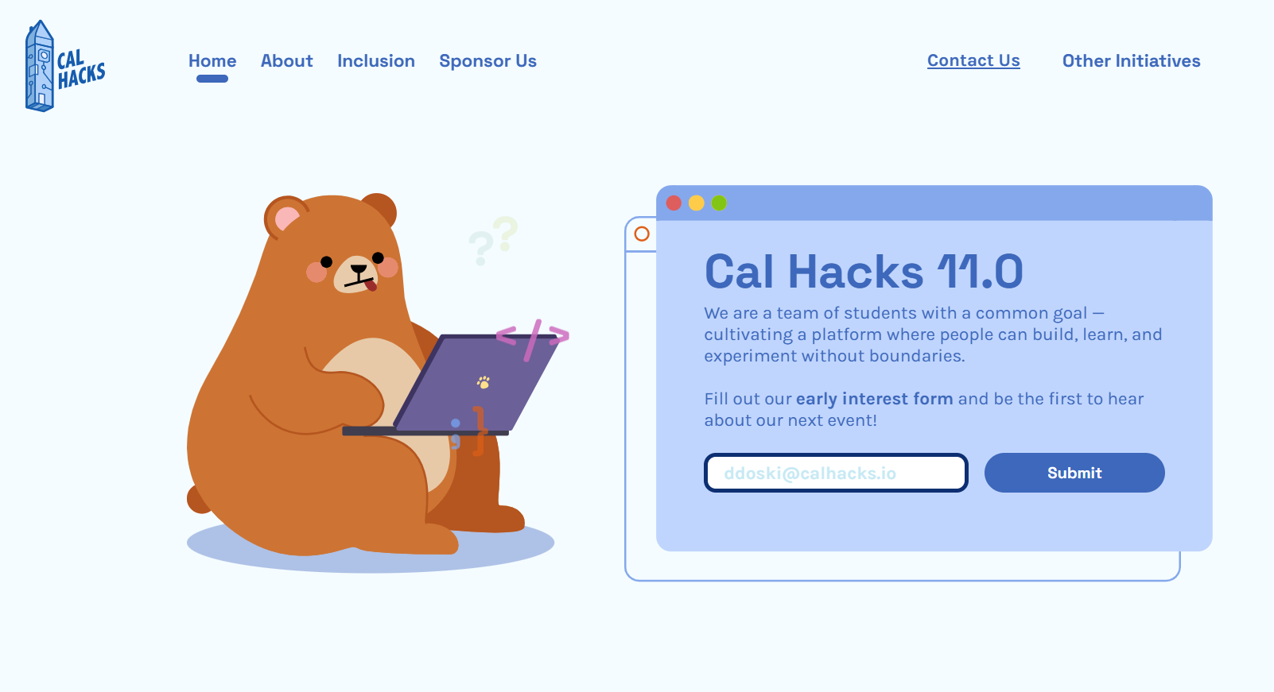
How to have fun with CS: Hackathons (https://www.calhacks.io/)

Slide 25
Your Life
Two long-term questions:
What am I capable of achieving?
Almost anything given time and motivation
What should I do with my life?
You will be in high demand by everyone.
Your skills will enable you to affect the world, possibly profoundly.
Technology will continually to radically reshape the way we live our lives.

Slide 26
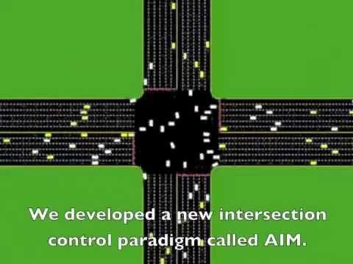
Choices (Yup)
How you use your skills is up to you.

Slide 27
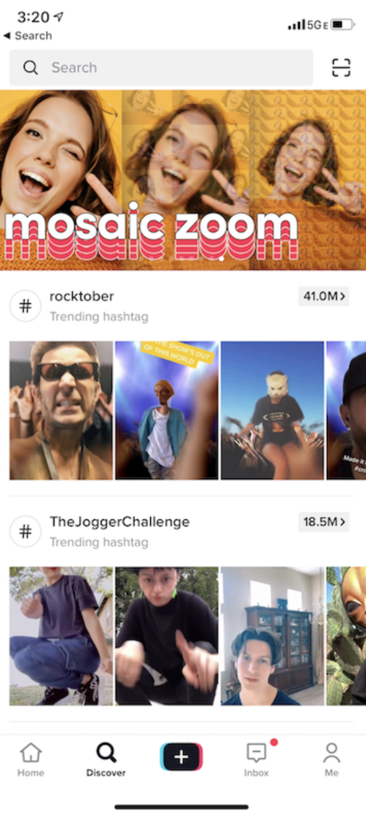
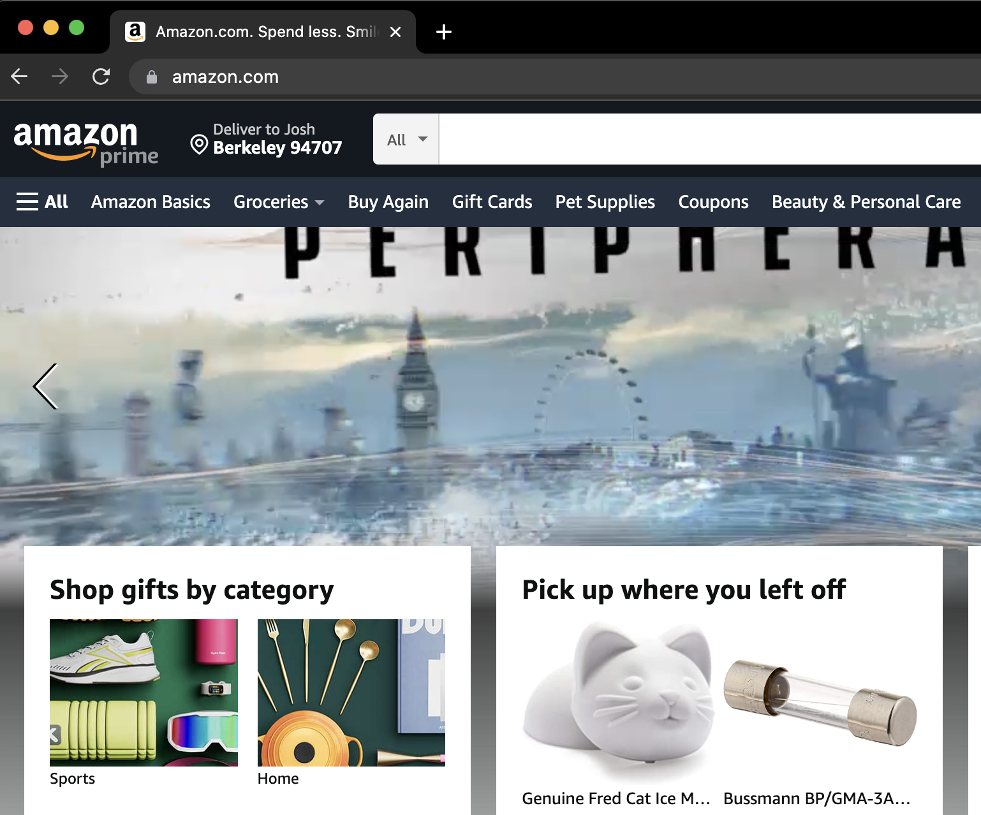
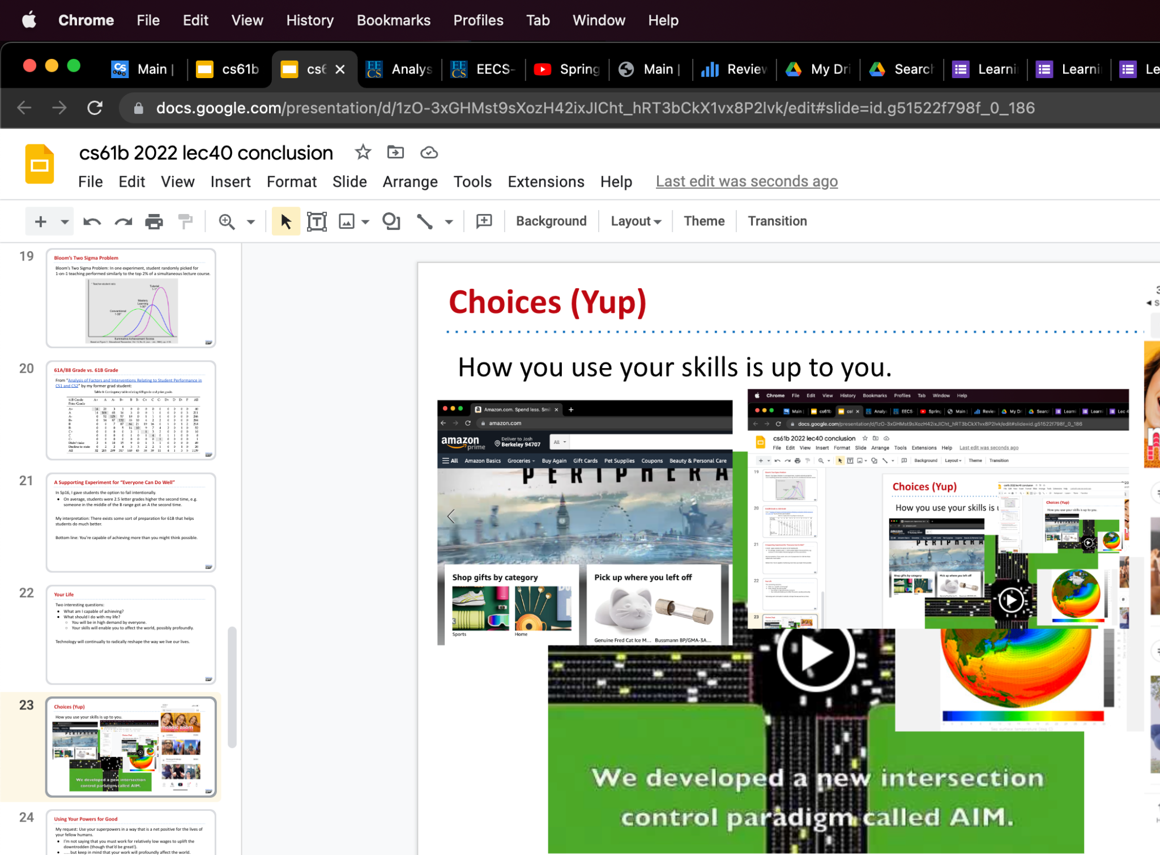
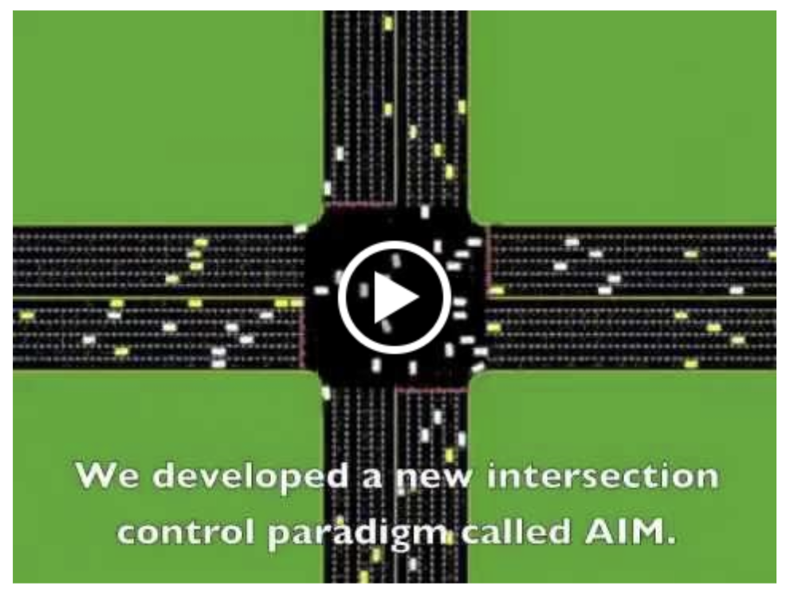
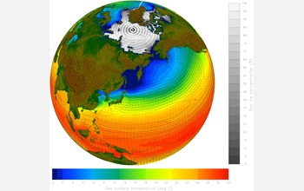
Choices (Yup)
How you use your skills is up to you.

Slide 28
Using Your Powers for Good
My request: Use your superpowers in a way that is a net positive for the lives of your fellow humans.
I’m not saying that you must work for relatively low wages to uplift the downtrodden (though that’d be great, of course).
…. but keep in mind that your work will profoundly affect the world.
(Wanna talk about this stuff more? Take CS195!)
Notes:
Josh: Does this seem surprising?

Slide 29
AMA
61B in 12 Minutes or Less
Your Future
AMA
Course Reflections
Lecture 40, CS61B, Spring 2023

Slide 30
Questions About Anything for Peyrin and Me?

Slide 31
Course Reflections
61B in 12 Minutes or Less
Your Future
AMA
Course Reflections
Lecture 40, CS61B, Spring 2023

Slide 32
Feedback Request
We read all of your feedback, especially on the end of course evaluations.
There is an official form from the university, and an internal survey for 61B that we’ll send out ourselves.
Course evaluations factor heavily into lecturer reviews, and let us know what bits of the class we can improve.

Slide 33
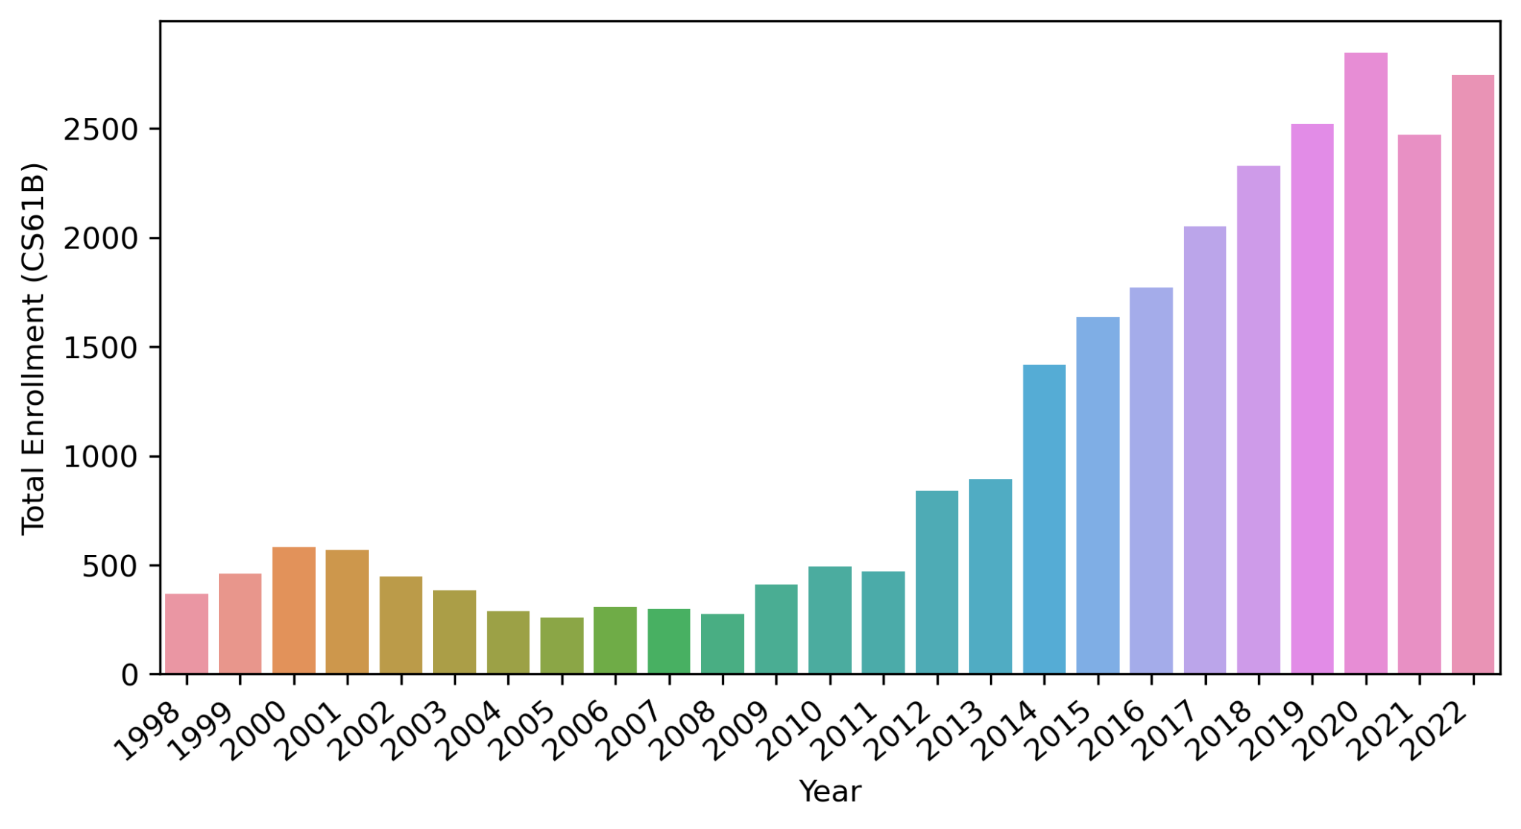
61B Would Love to Have You Next Fall
Academic interning: Learn more, help others, get units.
Watch out for an announcement on the Fall 2023 61B Ed.

Slide 34
Special Thanks to Our Academic Interns (who keep the wheels on the bus)

Slide 35
Special Thanks to the Staff (who keep the wheels on the bus)

Slide 36
Closing Thoughts (Peyrin)

Slide 37
Closing Thoughts
It is a terrifying and awesome responsibility to decide how you should spend hundreds of your precious hours here at Berkeley.
Don't worry about how others are doing, or focus on perfectly optimizing your college experience. Chances are, the choices you make now will lead to a good outcome. All you need to do is to be better than the person you were a year ago.
Personally, I teach because I believe that I am doing the most good for the world in this position. Please, prove me right.

